Slide 1
Sierra Community Medical Foundation ACEs/Wellness Summit September 30, 2022 Dennis McIntyre, MD, FAAP Medical Director Anthem Medicaid Health Plan
Notes:
<number>

Slide 2
Disclosure Statement
Disclosure/Conflicts of Interest: I have no financial relationships or conflicts of interest that I need to disclose.
With special thanks to Demetria Malloy, MD, whose work was instrumental in developing this presentation.
<number>
Notes:
<number>

Slide 3
Provider Support
<number>

Slide 4
Educating Providers on ACEs
Provider Engagement Team engages with providers in our network and educates them on the following:
ACEs Screening, benefits, and reimbursement
Updates on policy changes, regulations, ACEs certification, etc.
Provider Bulletins
Link: https://providers.anthem.com/california-provider/communications/news-and-announcements
Provider Portal
Link: https://providers.anthem.com/california-provider/home
<number>
Notes:
<number>

Slide 5
Billing and Reimbursement
How is Anthem supporting providers with billing and reimbursement on ACEs screening?
Anthem’s Provider Experience Team can assist providers with any billing/payment questions or escalations.
Billing – use HCPCS codes below:
G9919 - Screening performed — results positive and provision of recommendations provided: when the patient’s screening is determined to be high risk (a score of 4 or greater)
G9920 - Screening performed — results negative: when the patient’s screening is determined to be lower risk (a score between 0 and 3)
Reimbursement
Anthem Blue Cross (Anthem) is reimbursing Medi-Cal providers minimum fee of $29 for each qualifying ACE screening service.
<number>
Notes:
<number>

Slide 6
<number>
Notes:
<number>

Slide 7
Supporting Providers on ACEs Certification
Provider Engagement team educates and supports providers and IPAs/Physician Medical Groups (PMGs) in attaining ACEs certification.
Providers are directed to ACEs Aware for the following:
Learn how to get certified to screen for ACEs.
Attain training to learn about ACEs, screening tools, and trauma-informed care.
Link: https://www.acesaware.org/
<number>
Notes:
<number>

Slide 8
How do we help providers whose patient has a positive screening?
Connect providers to Anthem’s resources/programs to address the needs of our members:
Telehealth: LiveHealth Online
Care Management Program
Transportation Benefit
CalAIM: Enhance Care Management & Community Support
FindHelp.org
<number>
Notes:
<number>

Slide 9
LiveHealth Online
<number>

Slide 10
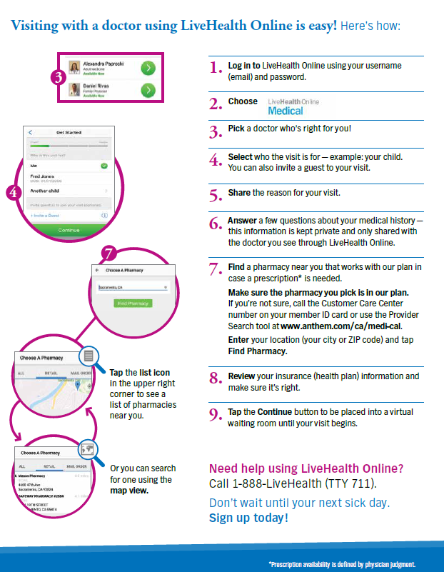
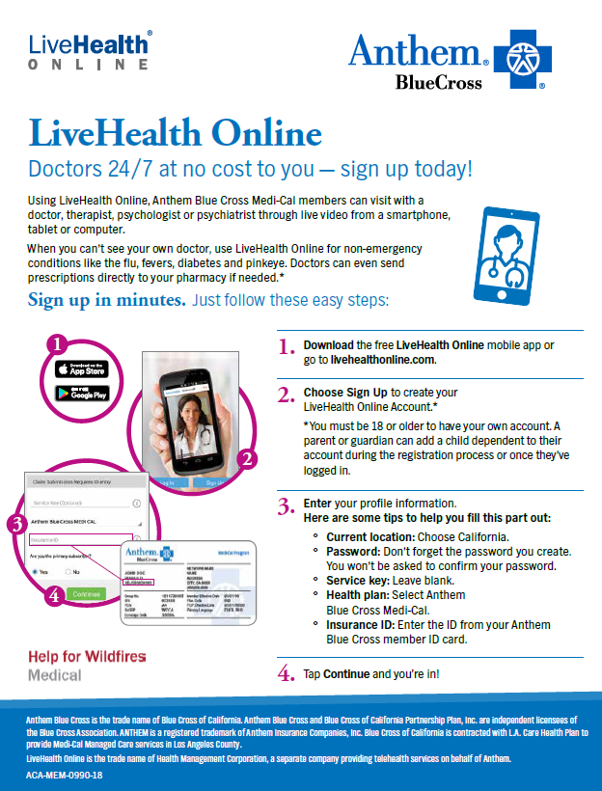
LiveHealth Online
<number>
Notes:
<number>

Slide 11
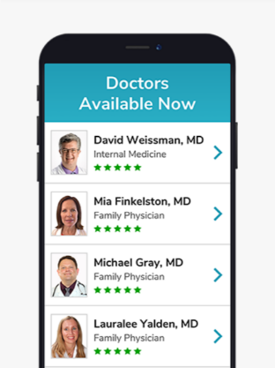
LiveHealth Online - Virtual Telehealth Providers
 | LiveHealth Online Medical | LiveHealth Online Psychiatry | LiveHealth Online Psychology
Provider types | Board-certified doctors | Board-certified doctors | Licensed psychologist (PhD) and therapist (social workers — masters level)
Benefit offered | Medication if clinically necessary | Medication if clinically necessary Post-initial evaluation
Availability | On demand 24/7/365 | Appointment: 8 a.m. to 8 p.m.; All time zones | Appointment: 7 a.m. – 11 p.m.
Visit length | 10 minutes | 30 to 45 minutes for initial evaluation; 15 minutes for follow-up sessions if needed for medication review | 45 minutes
Average wait time | About 10 minutes | 14 days or less | 4 days or less
Age served | No age limit, doctor determines if the patient can be treated virtually | 18 years or older | 10 years or older
Value | Convenient access to care at home. Prevents time consuming ER visits for nonemergent conditions. | Significantly increased access to behavioral health providers at home. Note, LHO is not intended to, nor can it, take the place of the patient’s PCP relationship and the services provided by their PCP.
<number>
Notes:
LiveHealth Online (LHO) is a website and mobile application that gives patients 24/7 access to on-demand video visits. It has an urgent care focus and provides convenient access anytime, anywhere in California via smartphone, tablet or computer
Using LHO, Anthem members can visit with a doctor, therapist, psychologist or psychiatrist through live video from a smartphone, tablet or computer
When members can’t see their own doctor, they can use LHO for nonemergency conditions like the flu, fevers, diabetes and pinkeye
To begin, download the free LiveHealth Online mobile app or go to livehealthonline.com
<number>

Slide 12
LiveHealth Online – Maternal Mental Health Service
<number>
Notes:
<number>

Slide 13
Care Management Program
<number>

Slide 14
Care Management Program
Connects members to specialty or subspecialty services
<number>
Notes:
Physical Health Care Management Program –
Provides telephonic assistance from licensed health professionals (including registered nurses and social workers) for our members who need support in managing their health and navigating the health care system
Works with our members in managing complex cases such as CHF, diabetes, high-risk pregnancy, substance use, mild to moderate behavioral health conditions, etc. and provides assistance with housing solutions for Anthem members who are experiencing homelessness is also available
Behavioral Health Case Management:
Provides outreach to members to support members’ progress towards their behavioral health goals.
Case managers are licensed mental health professionals who collaborate with health care partners to achieve members’ goals through education, technological support and the promotion of recovery ideals
<number>

Slide 15
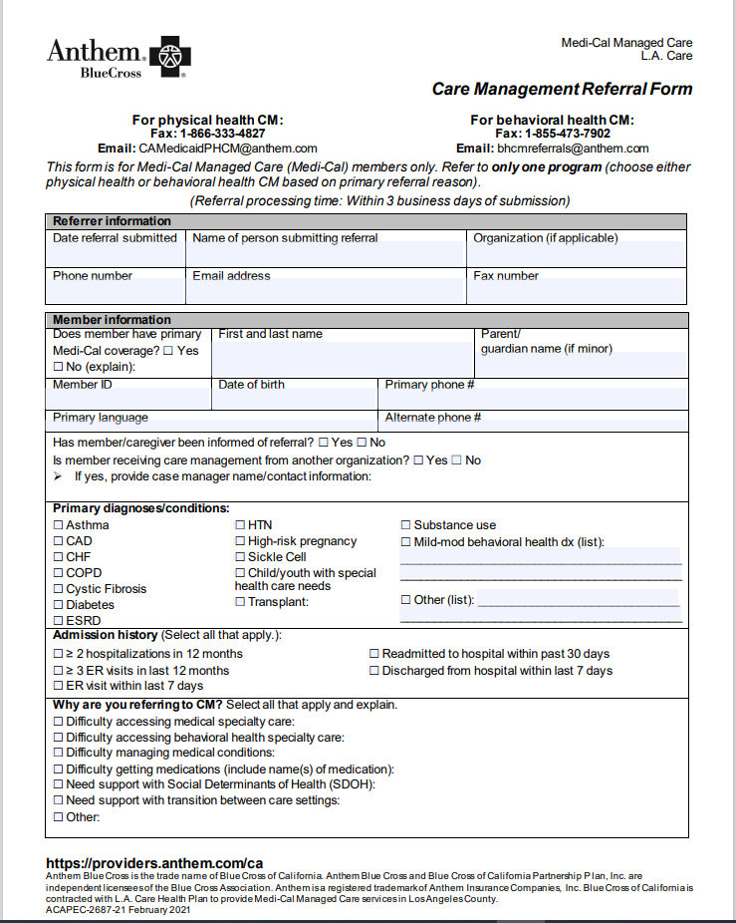
Care Management Referral
Referral Form for the following:
Physical Health
Behavioral Health
<number>

Slide 16
Transportation
<number>

Slide 17
Transportation ModivCare
<number>

Slide 18
California Advancing and Innovating Medi-(Cal-al-AIM
Enhanced Care Management (ECM)
Community Support (CS)
<number>

Slide 19
CalAIM- Enhanced Care Management
Populations of focus:
Individuals/families who are homeless or experiencing homelessness
High Utilizers adults
Severe Mental Illness / Substance Use Disorder (SMI/SUD) risk/adults
Nursing facility diversion
Nursing facility transition
Incarceration transition
Children and Youth
Core services:
Outreach and engagement
Comprehensive assessment and care management plan
Enhanced coordination of care
Health promotion
Comprehensive transitional care
Member and family supports
Coordination of and referral to community and social support services
<number>
Notes:
Population​ of Focus:
Homeless​ - Individuals and families (including children) experiencing homelessness and who have at least one complex physical, behavioral, or developmental health need with inability to successfully self-manage ​
High utilizers adults - Adult high utilizers with five or more preventable emergency room visits, or three or more unplanned hospital and/or short-term skilled nursing facility (NF) stays in a 6-month period
SMI/SUD risk adults​ - Adults with county severe mental illness (SMI) or substance use disorder (SUD) diagnosis and experiencing one complex social factor, and are (high risk or institutionalization, or user of crisis services, two or more ED visits or IP in past 12 months due to SMI/SUD-related hospitalizations, or pregnant)​
ECM seven core services:
Outreach and engagement
Comprehensive assessment and care management plan
Enhanced coordination of care
Health promotion
Comprehensive transitional care
Member and family supports
Coordination of and referral to community and social support services
<number>

Slide 20
Community Supports — 14 approved
Housing/homelessness (four services):
Housing transition navigation services
Housing deposits
Housing tenancy and sustaining
Day habilitation
Facilities (three services):
Short-term post-hospitalization housing (STPH)
Recuperative care (medical respite)
Sobering center
In-home supports (two services):
Respite services (can also be provided in a facility setting)
Personal care and homemaker services
Nursing homes linked (two services):
NF transition/diversion to assisted living facilities
Community transition services/NF transition to a home
Construction/equipment (two services):
Environmental accessibility adaptations (home modifications)
Asthma remediation
Meals (one service):
Meals/medically tailored meals
<number>
Notes:
<number>

Slide 21
Community Resources
<number>
Notes:
<number>

Slide 22
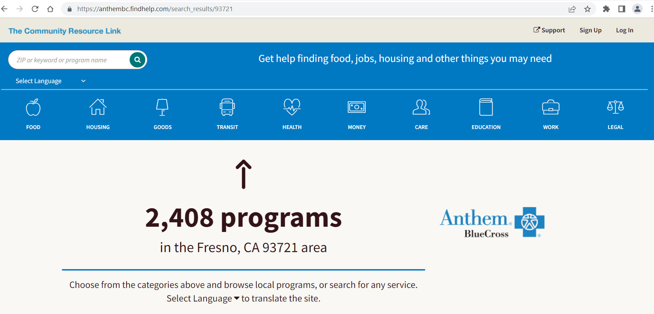
FindHelp.org
<number>
Notes:
<number>

Slide 23
Questions? Dennis McIntyre, MD, FAAP dennis.mcintyre@anthem.com (510) 542-0178 https://providers.anthem.com/california-provider/home
<number>
Notes:
<number>

Slide 24
https://providers.anthem.com/ca
Anthem Blue Cross is the trade name of Blue Cross of California. Anthem Blue Cross and Blue Cross of California Partnership Plan, Inc. are independent licensees of the Blue Cross Association. Anthem is a registered trademark of Anthem Insurance Companies, Inc. Blue Cross of California is contracted with L.A. Care Health Plan to provide Medi-Cal Managed Care services in Los Angeles County.
ACAPEC-XXXX-XX [rdate]

